Slide 1
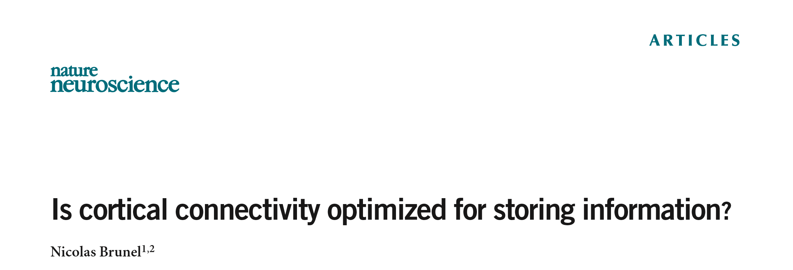
Ben Cohen

Slide 2

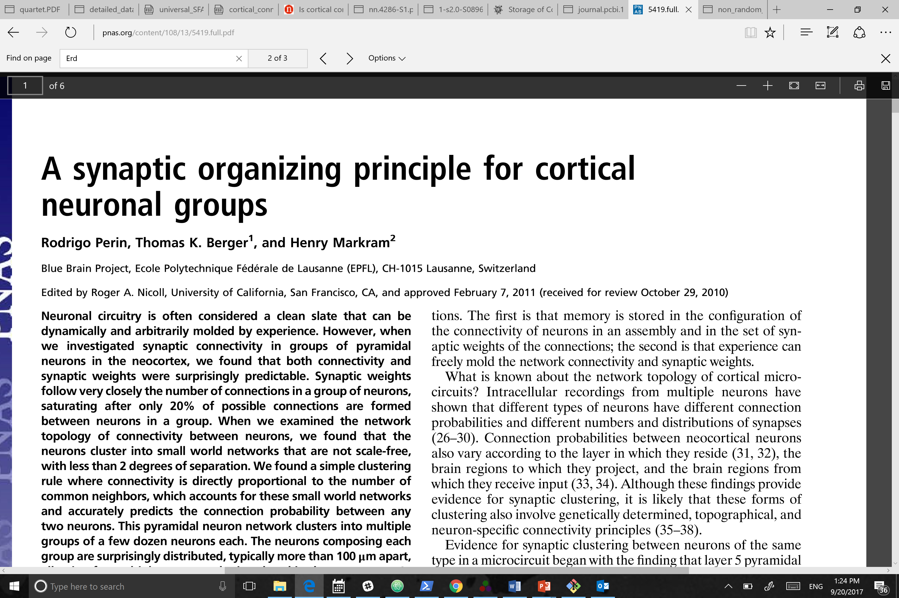
Neuroanatomy
Networks Optimized for Information Storage
?
Notes:
Connectivity is really structured on the level of 100s of microns
This paper is where Nick gets data for comparisons
Maybe this structure is useful for something

Slide 3
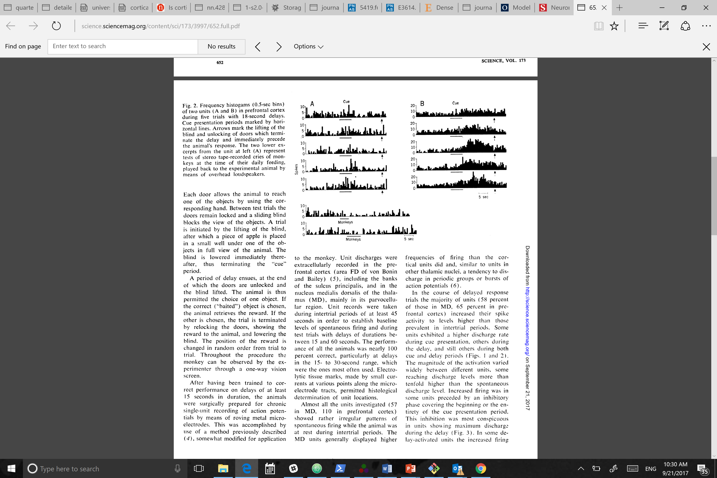
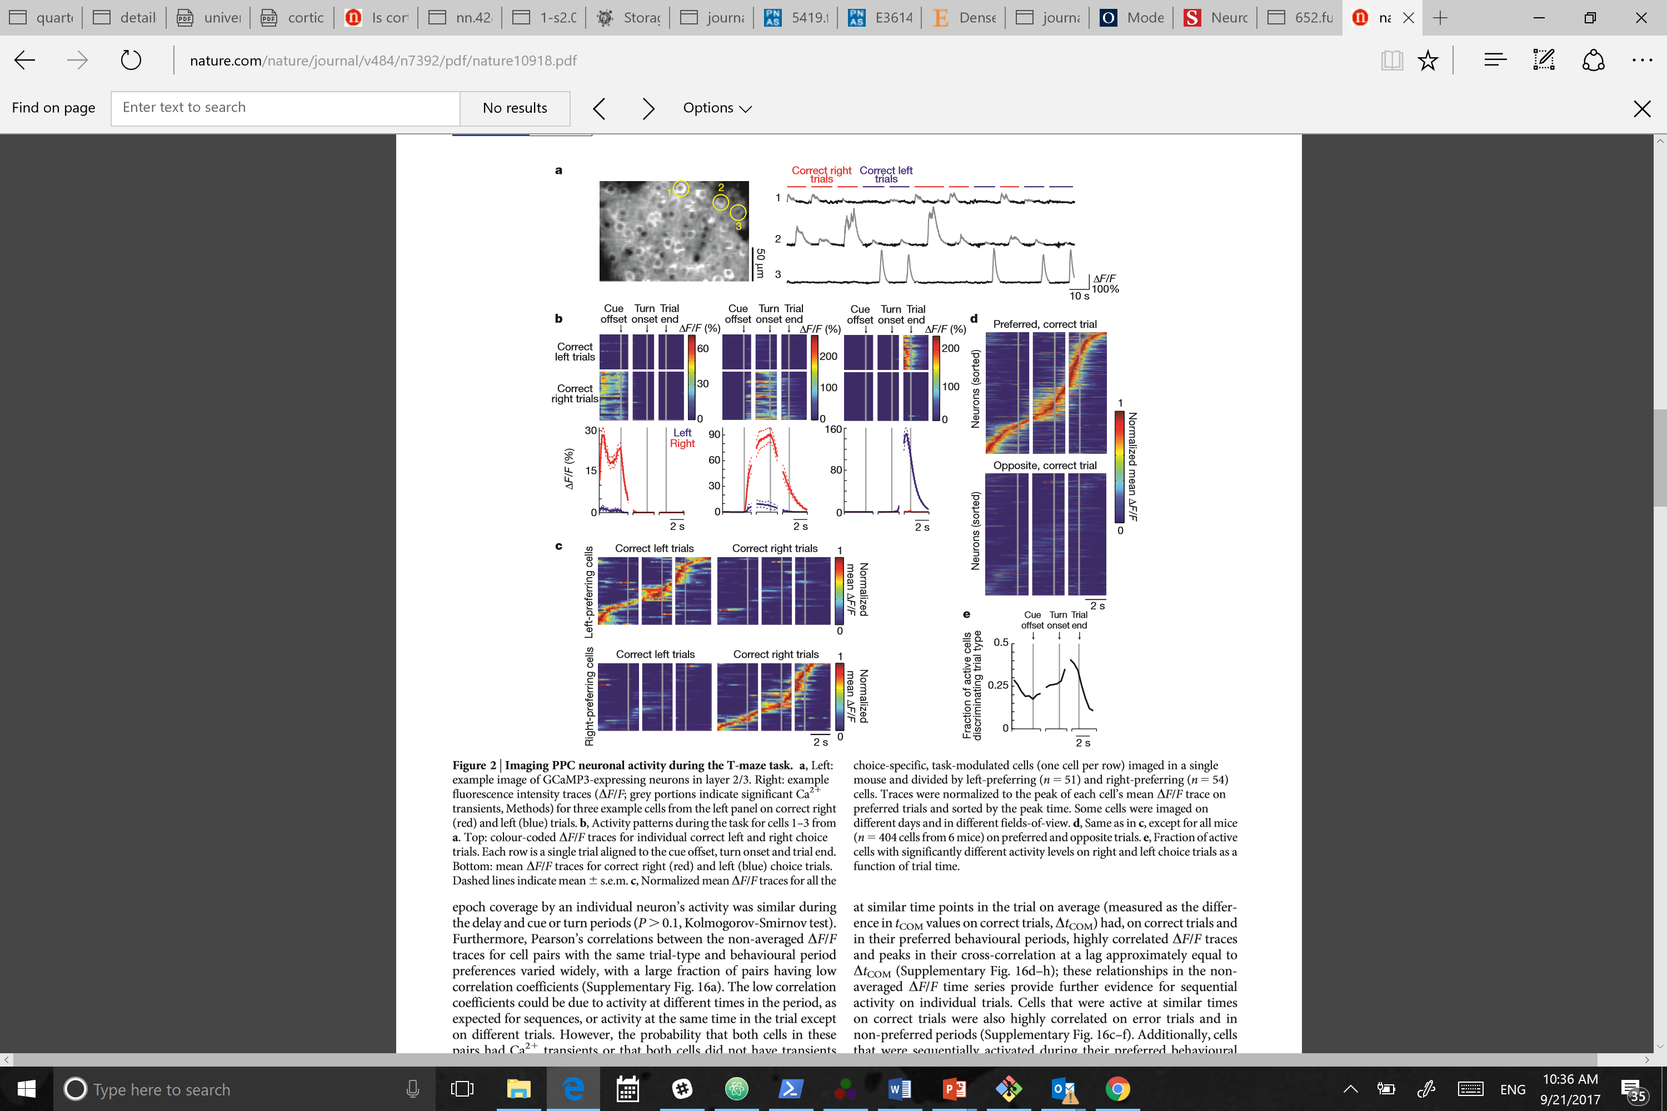
Storing Information
Attractor States
Sequences
Fuster & Alexander, 1971
Harvey et al, 2012

Slide 4
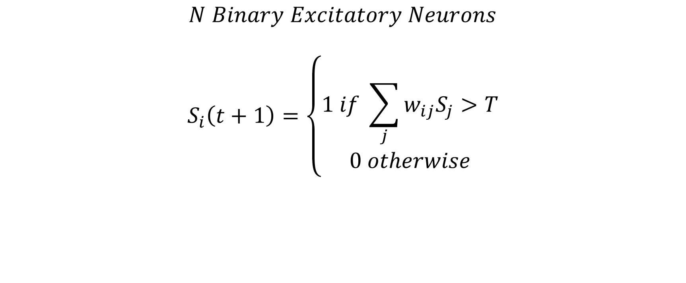
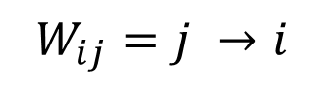
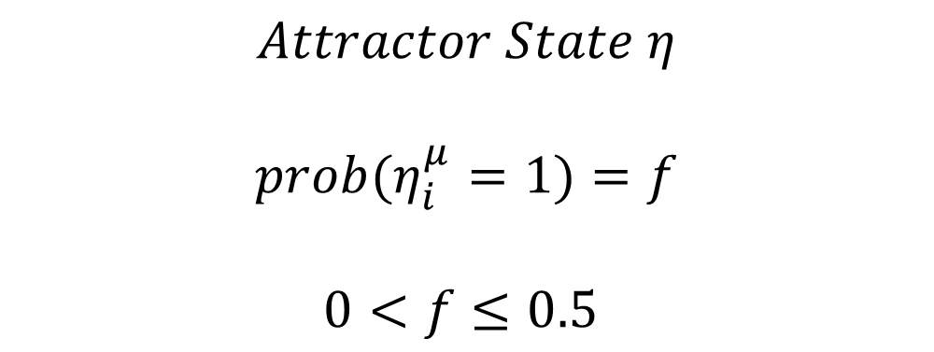
$$N Binary Excitatory Neurons$$
$$S_{i}\left(t+1\right)=\left\{\begin{aligned}1 if \sum_{j}{w_{ij}S_{j}}>T \\ 0 otherwise\end{aligned}\right.$$
$$W_{ij}=j →i$$
0 | 1 | 0 | 3
4 | 0 | 2 | 0
6 | 0 | 0 | 1
2 | 1 | 1 | 0
i=1
$$Attractor State η$$
$${prob(η}_{i}^{μ}=1)=f$$
$$0<f≤0.5$$
Notes:
Add up states * weights
Attractor state is a random bit string
Effectively incorporates inhibition by making T big

Slide 5
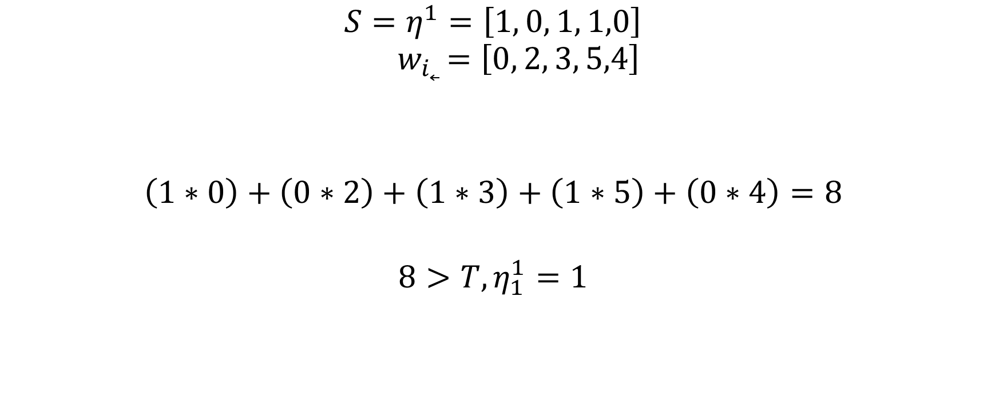
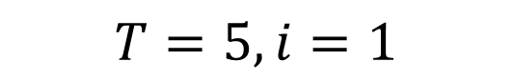
$$Perceptron Problem:Adjust w to classify η$$
$$T=5, i=1$$
$$S=η^{1}=\left[1, 0, 1, 1,0\right]$$
$${ w}_{i˿ }=\left[0, 2, 3, 5,4\right]$$
$$\left(1∗0\right)+\left(0∗2\right)+\left(1∗3\right)+\left(1∗5\right)+\left(0∗4\right)=8$$
$$8>T, η_{1}^{1}=1$$
Notes:
Add them up, and ask am I bigger than threshold?
Give some vector, classify it as 1 or zero with weights
Learning an attractor is equivalent to N perceptron problems
Learning p attractors is p*N perceptron problem

Slide 6
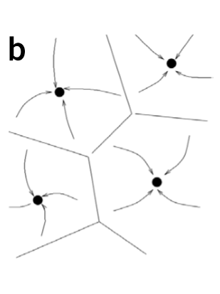
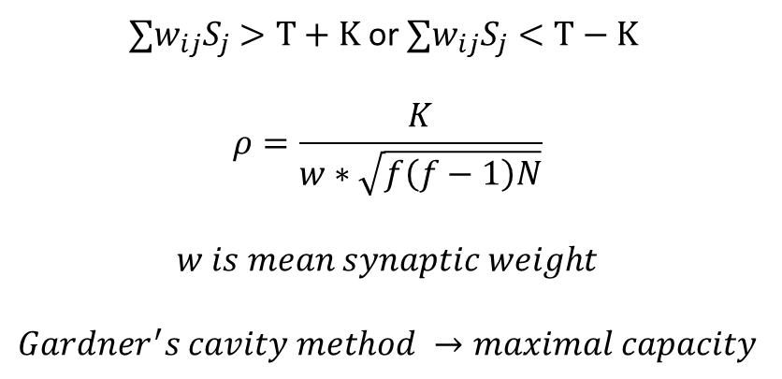
Matrix at Max Capacity
$∑w_{ij}S_{j}>T+K$ or $∑w_{ij}S_{j}<T−K$
$$ρ=\frac{K}{w∗\sqrt{f\left(f−1\right)N}}$$
$$w is mean synaptic weight$$
$$Gardner^{′}s cavity method →maximal capacity$$
Notes:
K is size of basins of attraction
You can maximize robustness give fixed p, or maximize p given foxed robustness
Brunel’s algorithm is :
Make a pattern
Learn it
Add a new one
Repeat until terminal criteria reached

Slide 7
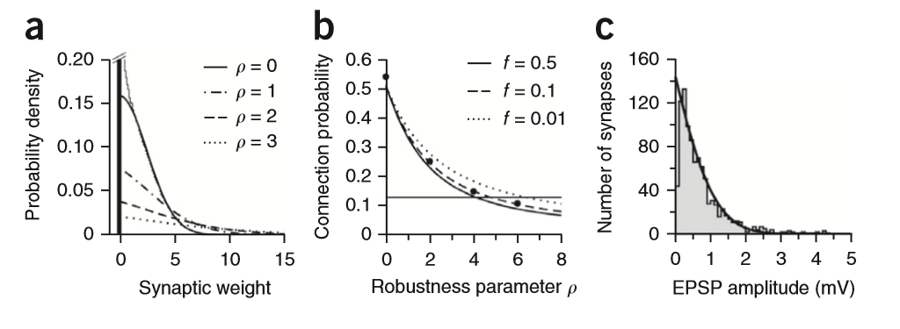
Distribution of Synaptic Weights
Notes:
A lot of zero synapses at optimal
To get more robust, you need to get more sparse
Anatomy is sparse
Distribution of weights in optimal vs experimental network

Slide 8
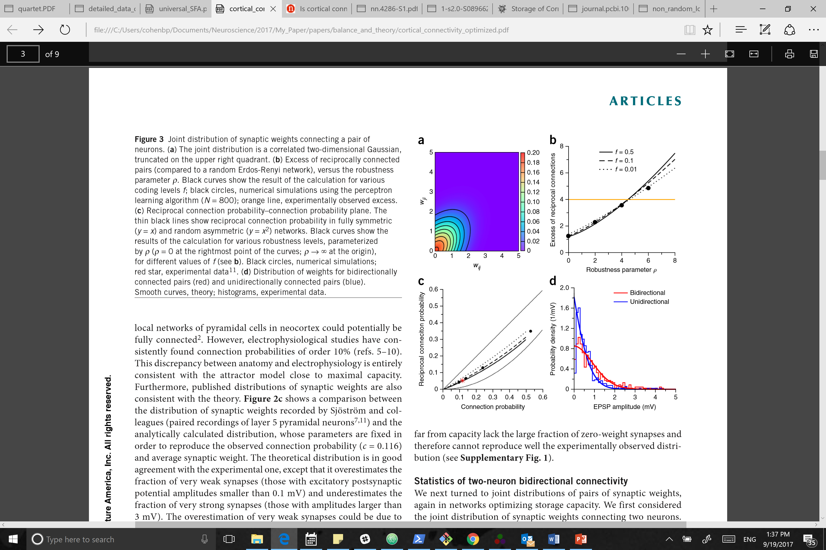
Reciprocal Connections
Notes:
IJ is correlated with JI
Reciprocal connections over-represented
Same
Bidirectional connections stronger

Slide 9
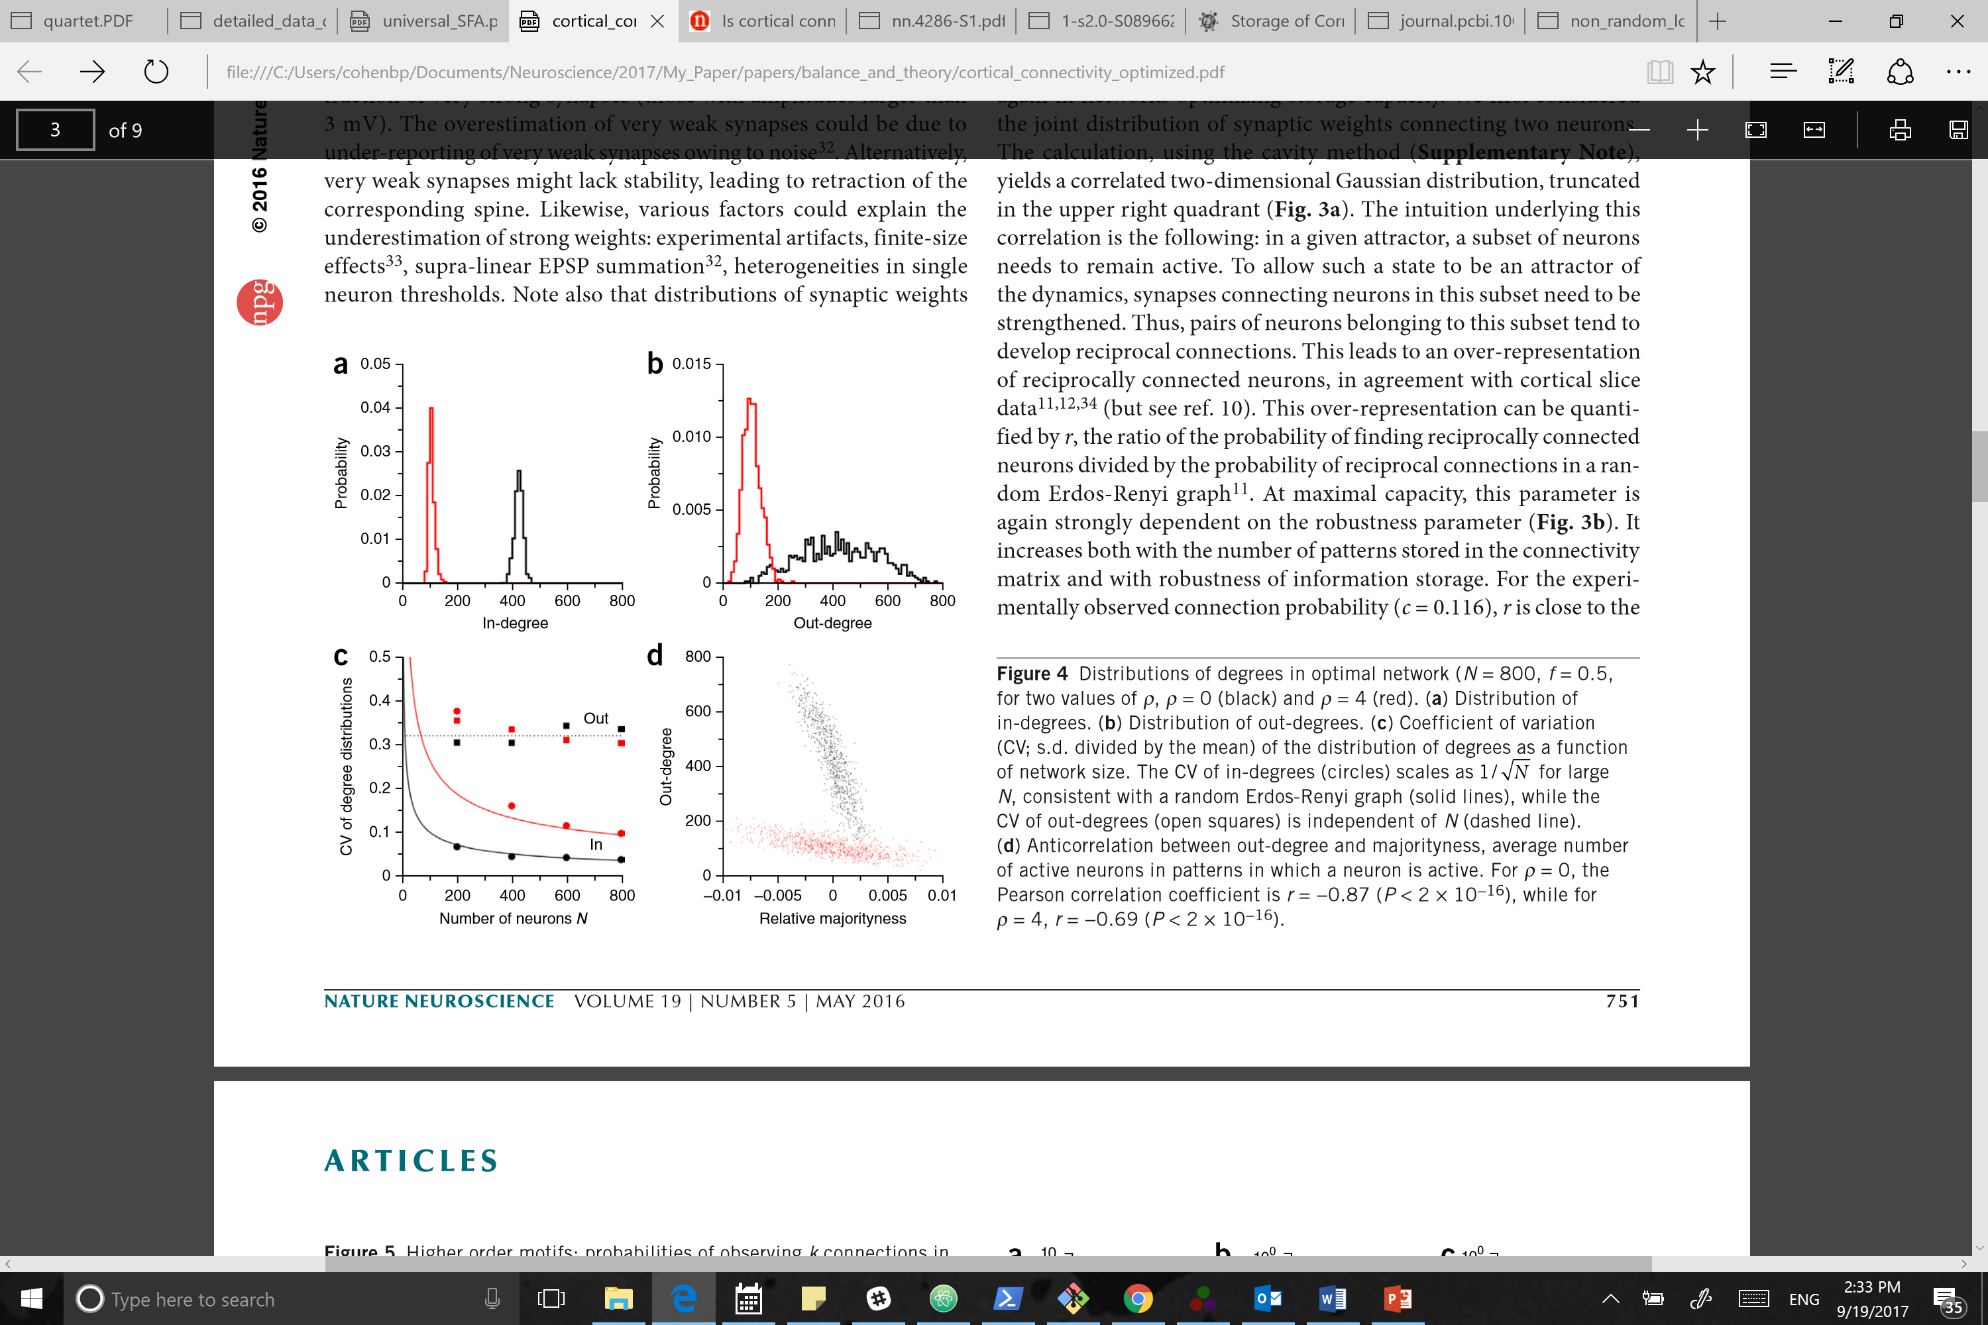
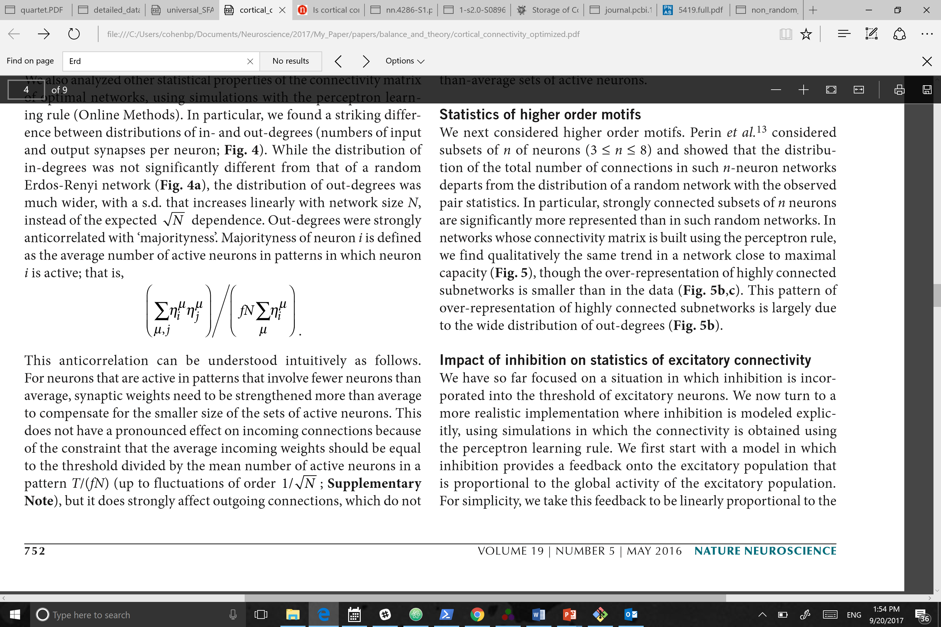
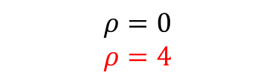
$$ρ=0$$
$$ρ=4$$
N = 800, f = 0.5
0 | 1 | 0 | 3
4 | 0 | 2 | 0
6 | 0 | 0 | 1
2 | 1 | 1 | 0
In Degree
= 3
Out Degree = 2
Majorityness
hipsters
mainstream
Notes:
Maximum # you get in degree = fN. Maximum robustness you get sparse in-degree.
Out degrees are more broadly distributed.
CV of in degree scales with 1/sqrt(N), out degree doesn’t care
Majorityness anti-correlated with out-degree.
Predicts that cortical neurons should have narrow (broad) in degree (out degree) distributions
Predicts that ‘hub’ neurons with many out-going connections participate in the sparsest patterns

Slide 10
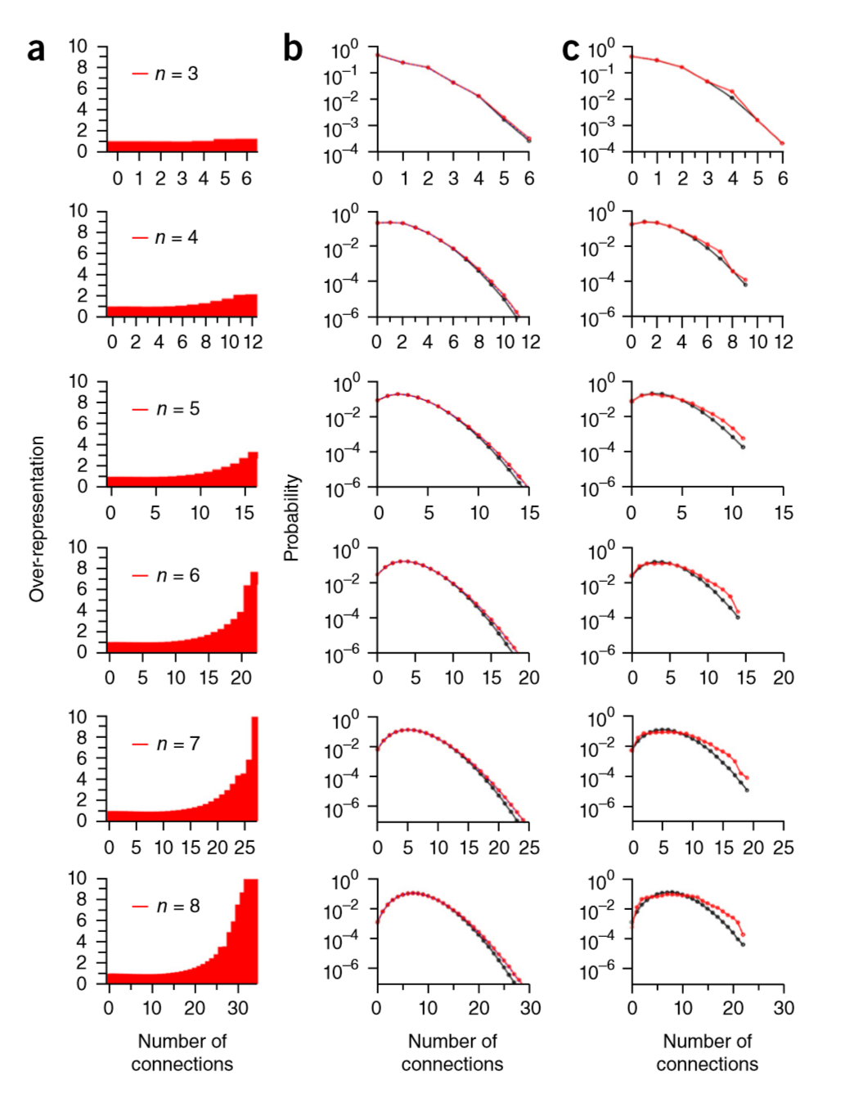
Clustered Motifs
Simulation
Cortical Slice
Notes:
C is cortex data from perin et al, comparing cortical slice to random Erods Renyi graphs
A shows that those motifs are also over-represented in the perceptron model
B shows that when you generate random graphs controlling for in and out degrees, you match the perceptron. So the over-representation observed by Nick is due mainly to the degree distributions.

Slide 11
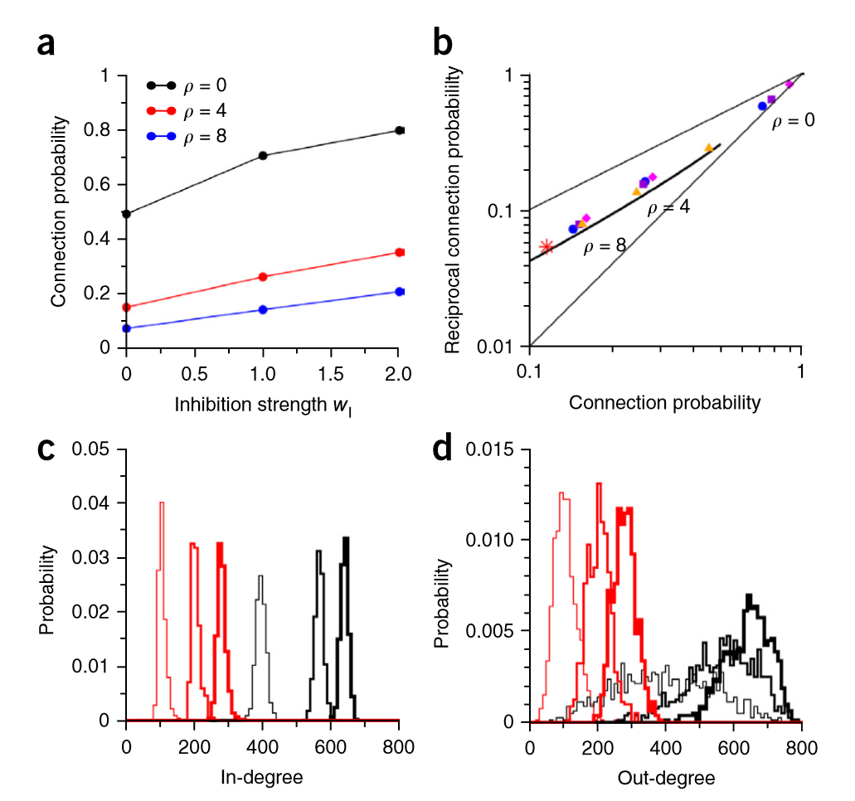
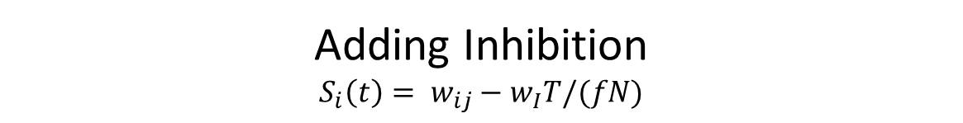
Adding Inhibition
$$S_{i}\left(t\right)= w_{ij}−w_{I}T/(fN)$$
Notes:
Inhibition strength increases connection probability, and reciprocal connection probability
Inhibition strength results in higher in-degree, and out-degree
Modeling individual inhibitory neurons and learning results in dense inhibitory connectivity, consistent with experiments.
In these models, E→E connections also decreased with increasing rho

Slide 12
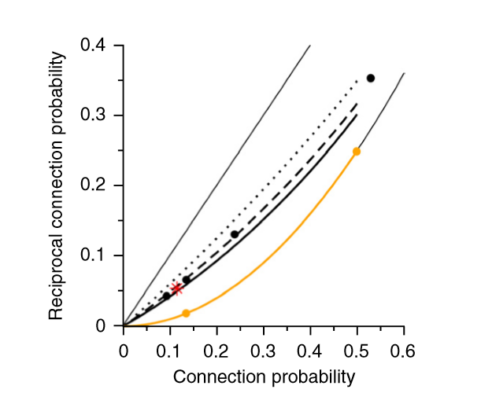
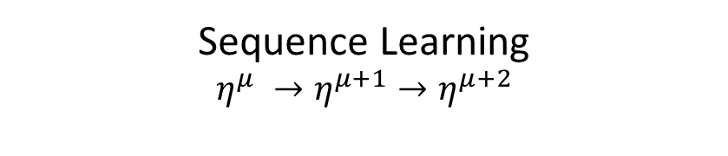
Sequence Learning
$η^{μ} →η^{μ+1}→η^{μ+2}$
Reciprocal connections ~null in sequence learning

Slide 14
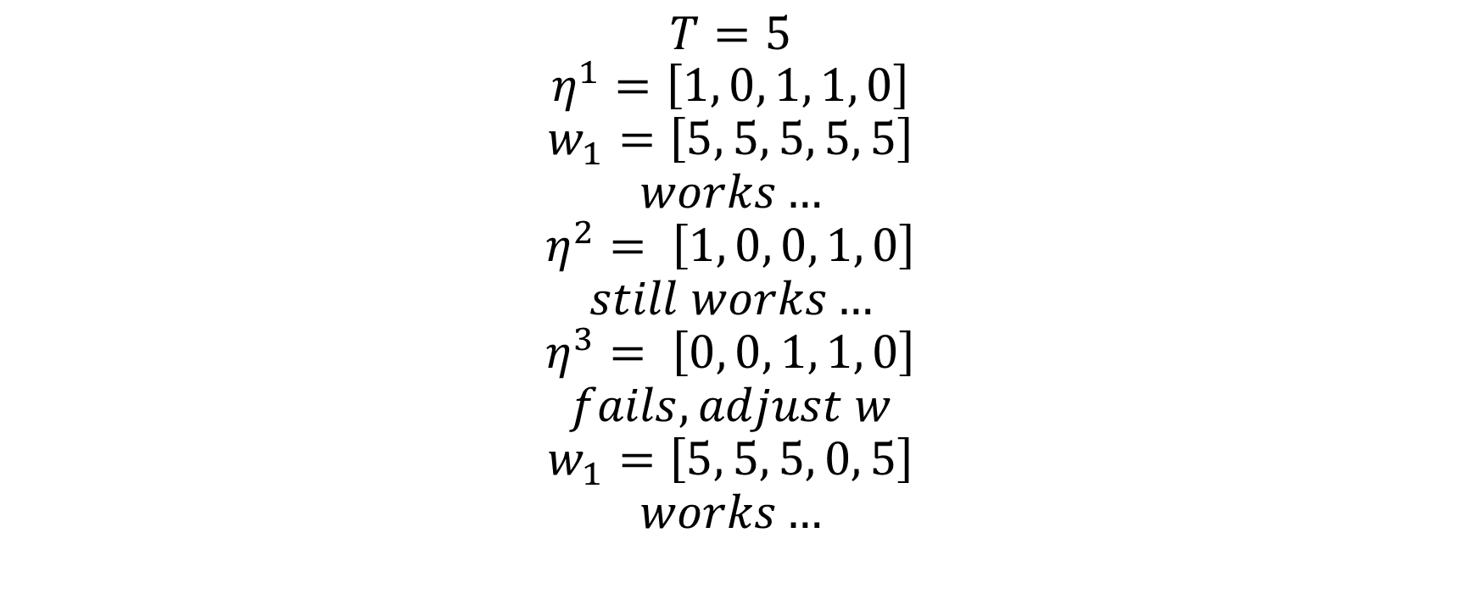
$$T=5 \\ η^{1}=\left[1, 0, 1, 1, 0\right]$$
$$w_{1}=\left[5, 5, 5, 5, 5\right]$$
$$works…$$
$$η^{2}= \left[1, 0, 0, 1, 0\right]$$
$$still works…$$
$$η^{3}= \left[0, 0, 1, 1, 0\right]$$
$$fails, adjust w$$
$$w_{1}=\left[5, 5, 5, 0, 5\right]$$
$$works…$$
Notes:
Brunel’s algorithm is :
Make a pattern
Learn it
Add a new one
Repeat until terminal criteria reached

Slide 15
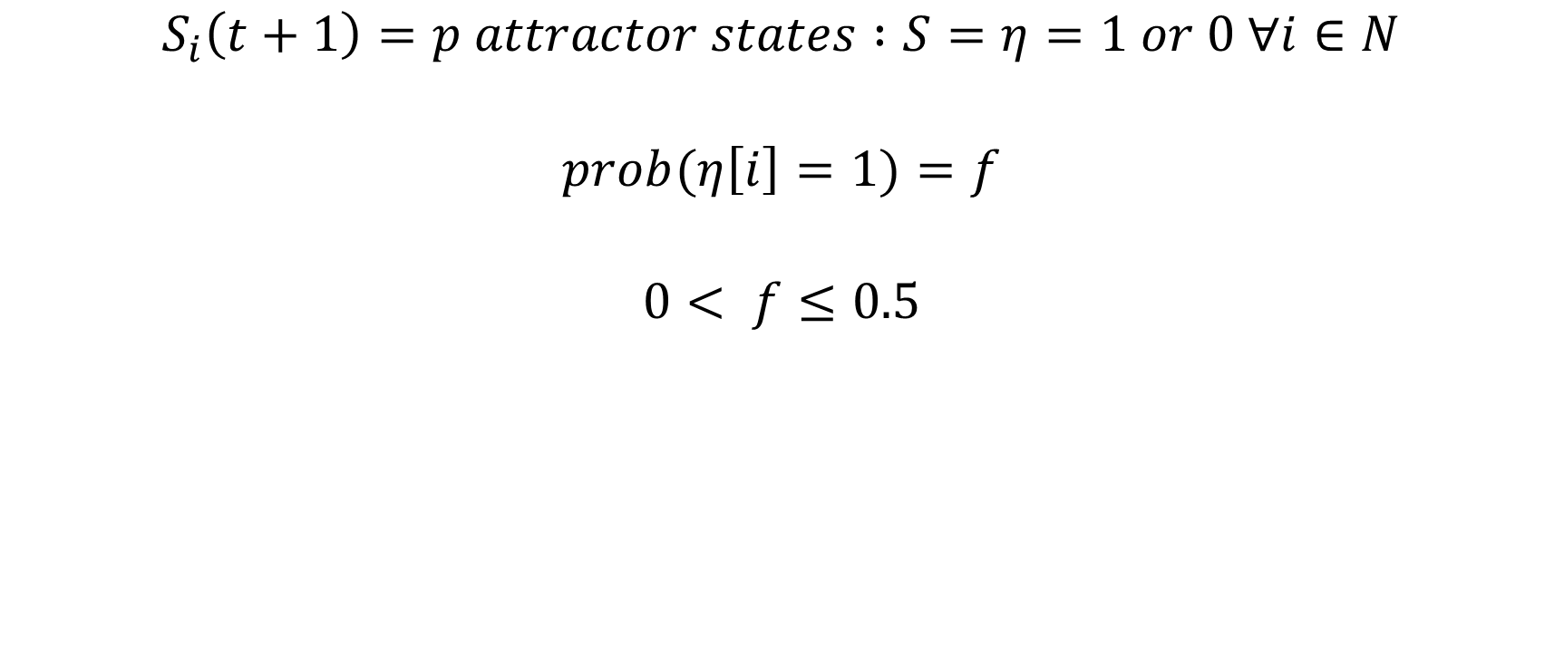
$$S_{i}\left(t+1\right)=p attractor states :S=η=1 or 0 ∀i∈N$$
$$prob(η\left[i\right]=1)=f$$
$$0< f≤0.5$$

